Slide 1





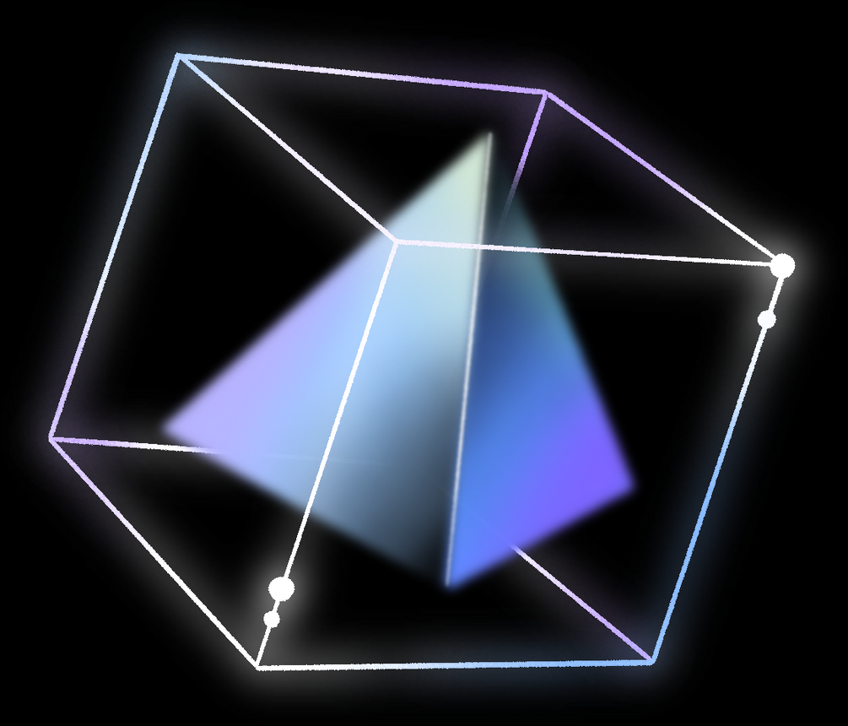
COLOUR SPACES IN
OPENCV
By Elise Zamora

Slide 2


INTRODUCTION
- A colour space is a specific organization of colours
- Enables consistent colour reproduction
- Mathematical model describing how colours can be represented
- Typically represented as three or four values or colour components
Artificial Intelligence
- Understanding colour spaces is essential for image processing and computer vision.
- Choosing the appropriate colour space can improve algorithm accuracy and efficiency.
- Proper colour space selection ensures consistent colour reproduction across different platforms and devices.
Notes:
Introduction to Color Spaces
What Are Color Spaces?
A color space is a specific organization of colors, enabling consistent color reproduction. They are mathematical models describing the way colors can be represented as tuples of numbers, typically as three or four values or color components.
Conclusion:
Understanding color spaces and their applications is essential for anyone working in image processing, computer vision, and related fields. By choosing the appropriate color space, developers and researchers can improve the accuracy and efficiency of their algorithms and ensure consistent color reproduction across different platforms and devices.

Slide 3
WHAT IS OPENCV?
OpenCV (Open Source Computer Vision Library):
- Open-source computer vision and machine learning software library
- Provides a common infrastructure for computer vision applications
- Accelerates the use of machine perception in commercial products
- OpenCV is a cornerstone library in computer vision
- It offers extensive tools and functionalities
- Applications range from simple image color transformations to sophisticated machine learning algorithms
- Versatile and easy to use
- Indispensable resource for developers, researchers, and enthusiasts in the field of computer vision
Notes:
Slide 2: What is OpenCV?
Brief Introduction to OpenCV:
OpenCV (Open Source Computer Vision Library) is a comprehensive library designed for computer vision and image processing tasks. It offers a wide range of tools and functions for image manipulation, feature detection, and object tracking, making it a cornerstone for developers and researchers in the field.
Conclusion:
OpenCV's versatility and powerful capabilities make it indispensable for a wide array of applications across industries and research fields. From enhancing image quality to enabling advanced computer vision features in robotics and autonomous systems, OpenCV continues to drive innovation and technological advancements.

Slide 4

OPTIMIZING COLOR SPACES FOR DEVICE CONSISTENCY AND ADVANCED IMAGE ANALYSIS
Consistency Across Devices:
Image viewing on multiple devices (monitors, mobile phones, printers)
- Importance of standardized colour space
- Variations in how devices interpret colour
Web development
- Importance of using sRGB colour space
- Ensures colour consistency across different web browsers and screens
- Maintains design integrity
Facilitates Specific Image Analysis Tasks:
Object tracking: HSV color space preferred over RGB
- Separates hue from lightness
- Easier to track objects under varying lighting conditions
- Hue remains more consistent than brightness
Skin detection algorithms: YCbCr color space frequently used
- Separates luminance from chrominance
- More effective than RGB for detecting skin tones under different lighting conditions
- Crucial for applications like gesture recognition and face detection.
Notes:
Importance of Color Spaces in Image Processing and Computer Vision:
Consistency Across Devices:
Example 1: Ensuring that the color of an image remains consistent when viewed on different devices, such as monitors, mobile phones, and printers. Without a standardized color space, the same image might appear differently on each device due to variations in how devices interpret color.
Example 2: In web development, using the sRGB color space ensures that colors appear similar across different web browsers and screens, maintaining design integrity.
Facilitates Specific Image Analysis Tasks:
Example 1: In object tracking, the HSV (Hue, Saturation, Value) color space is often preferred over RGB because it separates the color (hue) information from the lightness (value). This makes it easier to track objects under varying lighting conditions since hue remains more consistent than brightness.
Example 2: For skin detection algorithms, the YCbCr color space is frequently used. It separates luminance (Y) from chrominance (Cb and Cr), making it more effective for detecting skin tones under different lighting conditions compared to RGB. This is crucial for applications like gesture recognition and face detection.

Slide 5

COLOUR SPACES IN IMAGE PROCESSING
Wide Usage in Applications:
Image Color Transformations:
- Example 1: Converting images from one color space to another, such as from RGB to grayscale or from RGB to HSV.
- Example 2: Adjusting image contrast and brightness in the RGB color space.
- Face recognition using deep learning models:
- OpenCV integrates with deep learning frameworks like TensorFlow and PyTorch
- Enables the development and deployment of complex algorithms
- Processes images in various color spaces to recognize and classify human faces accurately
- Object detection and classification in videos and live streams:
- OpenCV can process video frames in real-time
- Detects and classifies objects using pre-trained machine learning models
- Widely used in applications like surveillance, vehicle navigation, and interactive installations
Complex Machine Learning Algorithms:
Notes:
Examples of OpenCV Usage:
Image Manipulation and Processing:
Example 1: Real-time Photo Editing Applications - OpenCV is used to develop applications that allow users to apply filters, adjust image characteristics (brightness, contrast, saturation), and perform complex photo editing functions in real time.
Example 2: Automated Image Enhancement Tools - Software solutions leverage OpenCV for automatic corrections of images, such as red-eye removal, color balance adjustments, and noise reduction, enhancing the quality of photographs without manual intervention.
Feature Detection and Object Tracking:
Example 1: Facial Recognition Systems - OpenCV's algorithms enable the development of facial recognition technology, used in security systems, user authentication, and personalized user experiences by identifying and verifying individuals through facial features.
Example 2: Autonomous Vehicle Navigation - OpenCV plays a crucial role in the development of autonomous driving systems, where it's used for object detection (vehicles, pedestrians), lane detection, and traffic sign recognition, contributing to the safety and efficiency of self-driving cars.
Complex Machine Learning Algorithms:
Example 1: Gesture Recognition for Interactive Applications - Incorporating OpenCV with machine learning, developers create systems that interpret human gestures as commands, enabling hands-free control in gaming, virtual reality, and smart home devices.
Example 2: Scene Understanding in Robotics - Robots equipped with vision capabilities use OpenCV and machine learning to analyze their surroundings, make decisions, and interact with objects and people, enhancing their autonomy and usefulness in complex environments.

Slide 6
SELECTING THE OPTIMAL COLOR SPACE FOR DIVERSE IMAGING NEEDS
A color space is a system for organizing colors.
- It enables accurate reproduction, communication, and digital representation of colors.
- The system represents colors as a set of numbers, typically three or four values.
- These values correspond to the color components.
- Each color space serves different purposes in image processing
- RGB is suitable for display purposes
- HSV is useful for tasks requiring color segmentation or detection
- LAB is ideal for tasks that require color accuracy and consistency across different mediums
- Understanding different color spaces is crucial for image processing and manipulation
- Choosing the right color space can make a significant difference in achieving desired outcomes
- Different color spaces have specific applications for digital media, photography, and advanced computer vision tasks
Notes:
Basics of Color Spaces
Definition of Color Space:
A color space is a specific organization of colors, created to facilitate the consistent reproduction, communication, and digital representation of colors. It enables colors to be represented as tuples of numbers, typically three or four values, corresponding to color components.
Each Color Space Serves Different Purposes in Image Processing:
The choice of color space can greatly affect the outcome and efficiency of image processing tasks. For example, RGB is suited for display purposes, HSV for tasks requiring color segmentation or detection, and LAB for tasks that require color accuracy and consistency across different mediums.
Conclusion:
Understanding the basics of different color spaces and their specific applications is crucial for effectively processing and manipulating images. Whether it's for digital media, photography, or advanced computer vision tasks, choosing the right color space can make a significant difference in achieving desired outcomes.

Slide 7


EXAMPLES OF COMPLEX MACHINE LEARNING ALGORITHMS USING OPENCV
Face recognition using deep learning models:
- OpenCV integrates with deep learning frameworks like TensorFlow and PyTorch
- Enables the development and deployment of complex algorithms
- Processes images in various color spaces to recognize and classify human faces accurately
Object detection and classification in videos and live streams:
- OpenCV can process video frames in real-time
- Detects and classifies objects using pre-trained machine learning models
- Widely used in applications like surveillance, vehicle navigation, and interactive installations
Notes:
Common Examples of Color Spaces:
RGB (Red, Green, Blue):
Example 1: Digital Screens - The RGB color space is used in digital displays such as computer monitors, televisions, and smartphones. Each color on the screen is created by combining different intensities of red, green, and blue light. This combination allows the display to produce a wide range of colors.
Example 2: Digital Photography - Most digital cameras capture images using sensors that record light in the RGB color space. This allows for accurate reproduction of the scene's colors when viewed on RGB displays.
HSV (Hue, Saturation, Value):
Example 1: Color Selection Tools - Many graphic design and photo editing software use the HSV color space in their color pickers because it allows users to select colors based on hue, saturation, and brightness levels, which are more intuitive for humans to understand than RGB values.
Example 2: Color Filtering - In computer vision, the HSV color space is useful for tasks like color-based object detection and tracking because it separates the color information (hue) from the lighting information (value), making it easier to ignore lighting variations.
LAB (Lightness, A, B):**
Example 1: Color Correction - The LAB color space is widely used in image processing for color correction and enhancement because it models human vision. It separates lightness from color information, allowing adjustments to be made without affecting the color saturation.
Example 2: Digital Printing - LAB is also used in the printing industry to ensure accurate color reproduction across different materials and inks. Since it's device-independent, colors specified in LAB can be more consistently matched in physical print media.

Slide 8

UNDERSTANDING THE RGB COLOUR SPACE
- RGB color space is based on three primary colors: Red, Green, and Blue
- Colors are produced by combining these three colors in varying intensities
- This color space is additive, meaning that colors are created by adding light
- The combination of all three primary colors in full intensity produces white
- The RGB color space is essential for digital imaging and design.
- It provides a broad spectrum of colors suitable for electronic displays and digital media creation.
- However, it has limitations, mainly in color matching and perceptual adjustments.
- Understanding and choosing the right color space is crucial for specific tasks such as printing or color correction.
- Other color models might be more appropriate depending on the task at hand.
Notes:
Slide 4: RGB Color Space
Description of RGB Color Space:
The RGB color space is based on three primary colors: Red, Green, and Blue. In digital devices, colors are produced by combining these three colors in varying intensities. This color space is additive, meaning that colors are created by adding light, with the combination of all three primary colors in full intensity producing white.
Conclusion:
The RGB color space is fundamental to digital imaging and design, offering a wide range of colors suitable for electronic displays and digital media creation. However, its limitations, particularly in color matching and perceptual adjustments, highlight the importance of understanding and choosing the appropriate color space for specific tasks, such as printing or color correction, where other color models might be more suitable.

Slide 9

USES AND LIMITATIONS OF THE RGB COLOUR SPACE
USE CASES OF RGB COLOR SPACE:
LIMITATIONS OF RGB COLOR SPACE:
DIGITAL IMAGING:
COLOR MATCHING:
HUMAN PERCEPTION:
GRAPHIC DESIGN:
- Digital Imaging:
- Digital Camera
- Screen Display
- Web Design
- Digital Art
- Printing Challenges
- Device Dependency
- Non-Intuitive Adjustments
- Limited by Brightness
Notes:
Use Cases of RGB Color Space:
Digital Imaging:
Example 1: Digital Cameras - Digital cameras use the RGB color model to capture images. The camera's sensor divides light into the three primary colors, and each pixel in the image is recorded using a combination of these colors to accurately reproduce the captured scene.
Example 2: Screen Display - All digital screens, including computer monitors, smartphones, and TVs, use the RGB color space to display images and videos. By adjusting the intensity of each primary color, the screen can create millions of different colors, providing rich and vibrant visual content.
Graphic Design:
Example 1: Web Design - RGB is the standard color space for web content. Designers use RGB color values when creating websites to ensure that colors appear correctly on any digital device.
Example 2: Digital Art - Artists working with digital media often use RGB color space because it is natively supported by digital drawing and painting software, allowing for a wide range of colors that are suitable for screens.
Limitations of RGB Color Space:
Color Matching:
Example 1: Printing Challenges - Since RGB is designed for light-emitting devices, it doesn't translate directly to print media, which uses the CMYK color space. Colors that look vibrant on a screen may not appear the same when printed.
Example 2: Device Dependency - The exact appearance of RGB colors can vary from one device to another due to differences in hardware and calibration, making color matching across different screens a challenge.
Human Perception:
Example 1: Non-Intuitive Adjustments - Making adjustments in RGB to achieve certain hues or saturation levels can be less intuitive than in color spaces like HSV or HSL, which are designed to more closely align with the way humans perceive color.
Example 2: Limited by Brightness - In RGB, brightness is tied to color intensity, which can make it difficult to independently adjust the brightness or contrast of an image without affecting its colors.

Slide 10
HSV COLOUR SPACE
- HSV stands for Hue, Saturation, and Value
- Hue represents the type of color
- Saturation measures the intensity of the color
- Value reflects the brightness
- The HSV model is useful for color segmentation and image processing tasks
- It represents colors in a way that is more aligned with human perception of colors.
- Better for color segmentation, filtering, and analysis
- Useful in applications where human color perception is important
- Allows for independent color adjustments
- Adopted in various fields of computer vision, image processing, and design
- Overcomes limitations of RGB color space, especially under varying lighting conditions
HSV Colour Space Advantages:
Notes:
### Slide 5: HSV Color Space
**Description of HSV Color Space:**
- HSV stands for Hue, Saturation, and Value. This color space represents colors in a way that is more aligned with human understanding of colors. Hue represents the color type, saturation represents the intensity of the color, and value reflects the brightness. The HSV model is particularly useful for color segmentation and image processing tasks where color distinction is crucial.
The HSV color space offers significant advantages for color segmentation, filtering, and analysis, particularly in applications where human color perception and independent color adjustments are important. Its adoption in various fields of computer vision, image processing, and design underscores its utility in overcoming some of the limitations inherent in the RGB color space, especially under varying lighting conditions.

Slide 11





1. BETTER PERFORMANCE UNDER VARYING LIGHTING CONDITIONS:
1. COLOR FILTERING AND SEGMENTATION:
2. COMPUTER VISION AND IMAGE ANALYSIS:
2. INTUITIVE COLOR ADJUSTMENTS:
- Object Tracking in Videos
- Image Editing Software
- Skin Detection
- Real-Time Video Processing
- Graphic Design
- Photo Retouching
Example: OpenCV Code for Converting RGB to HSV.
- Automated Outdoor Systems
- Agricultural Automation
Notes:
**Use Cases of HSV Color Space:**
1. **Color Filtering and Segmentation:**
- **Example 1:** Object Tracking in Videos - In computer vision, the HSV color space is used to track objects based on their color. By isolating a specific hue range, applications can more easily follow an object throughout a video sequence, despite variations in brightness or saturation.
- **Example 2:** Image Editing Software - Many image editing programs use HSV for color correction and filtering because it allows users to manipulate colors in a more intuitive way than RGB. For example, adjusting the saturation to make a color more or less vivid without changing its hue.
2. **Computer Vision and Image Analysis:**
- **Example 1:** Skin Detection - The HSV color space is effective for detecting skin tones in images and videos because it can isolate colors based on hue and saturation, making it less sensitive to lighting changes compared to RGB.
- **Example 2:** Real-Time Video Processing - HSV is used in real-time video processing for tasks such as gesture recognition or augmented reality applications, where quick and accurate color detection is necessary to overlay graphics or identify gestures.
**Benefits for Certain Applications:**
1. **Better Performance Under Varying Lighting Conditions:**
- **Example 1:** Automated Outdoor Systems - For systems that operate outdoors, like surveillance cameras or autonomous vehicles, the HSV color space can improve object detection and classification performance by reducing the impact of changing lighting conditions throughout the day.
- **Example 2:** Agricultural Automation - In precision agriculture, HSV-based image analysis helps in identifying plant diseases or ripeness of fruits by distinguishing color variations more effectively than RGB, despite outdoor lighting changes.
2. **Intuitive Color Adjustments:**
- **Example 1:** Graphic Design - Graphic designers often prefer HSV for creating color palettes because adjusting the hue, saturation, or brightness values independently offers more control over the final appearance of the color, enabling precise color matching and theme creation.
- **Example 2:** Photo Retouching - Photographers and photo retouchers use HSV to make specific color adjustments in post-processing. For instance, enhancing the sky's blue or making the grass greener without affecting other colors in the photo.
**Example OpenCV Code for Converting RGB to HSV:**
- A simple demonstration of converting an image from RGB to HSV color space using OpenCV can illustrate the practical application of HSV in image processing tasks. This conversion is crucial for many of the aforementioned use cases, allowing for more effective color-based analysis and manipulation in computer vision projects.
**Conclusion:**

Slide 12

LAB COLOR SPACE
- LAB colour space, also known as CIELAB, approximates human vision
- Three axes: L* for lightness, a* for green-red, b* for blue-yellow
- Device-independent, produces consistent colours regardless of display method.
- LAB colour space is essential for colour accuracy and consistency.
- It closely mimics human visual perception.
- It is used for colour correction, enhancement, and analysis.
- It is device-independent, ensuring consistency across different platforms.
- Preferred choice for photography, film, manufacturing, and brand management professionals.
Notes:
### Slide 6: LAB Color Space
**Overview of LAB Color Space:**
- The LAB color space, also known as CIELAB, is designed to approximate human vision. It consists of three axes: L* for lightness, and a* and b* for the color spectrums green–red and blue–yellow, respectively. This color space is unique because it is device-independent, meaning it aims to produce consistent colors regardless of the device or method used to display the image.
**Conclusion:**
The LAB color space plays a crucial role in fields where color accuracy and consistency are paramount. Its ability to closely mimic human visual perception makes it invaluable for color correction, enhancement, and analysis across a wide range of applications. Its device-independent nature ensures that colors remain consistent across different viewing conditions and platforms, making it a preferred choice for professionals in photography, film, manufacturing, and brand management.

Slide 13
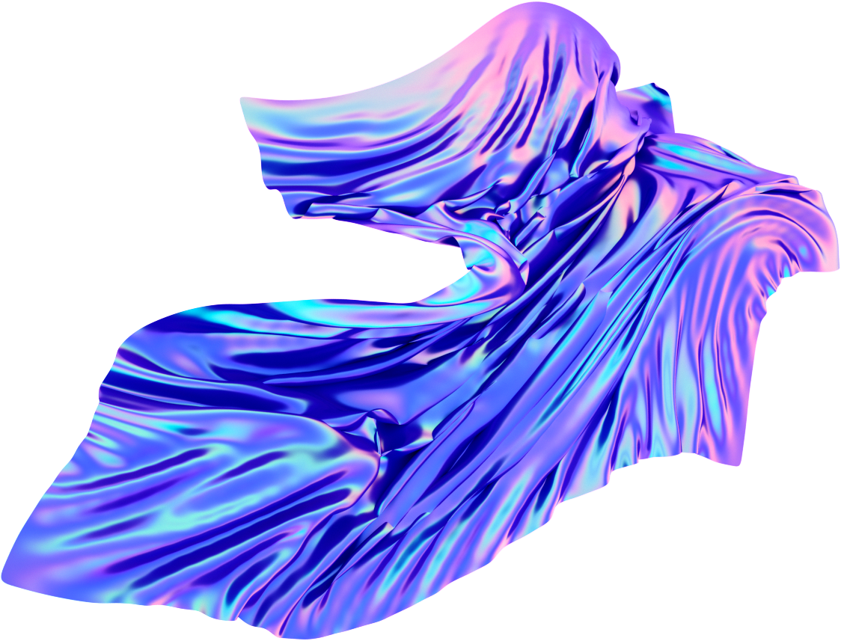
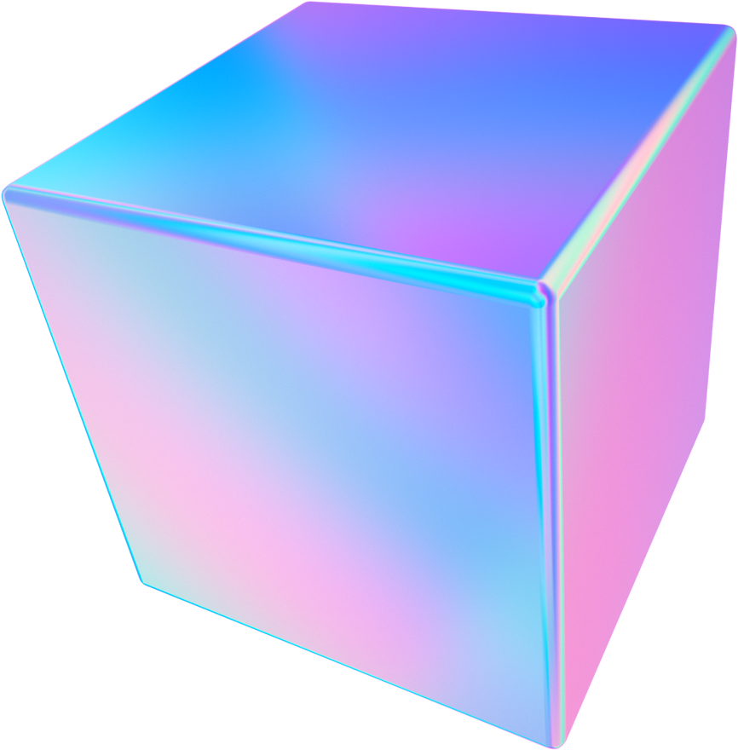

Face recognition using deep learning models:
Use Cases of LAB Color Space:
- Color Correction and Enhancement:
- Professional Photo Editing
- Art Restoration
- Advanced Image Analysis:
- Product Quality Control
- Agricultural Analysis
Face recognition using deep learning models:
Advantages for Color Differentiation:
- More Aligned with Human Vision:
- Color Grading in Film
- Cosmetic Industry
- Device-Independent Color Representation:
- Cross-Platform Digital Content Creation
- Brand Identity Design
Sample OpenCV Code for RGB to LAB Conversion:
- Demonstrates how to convert an image from RGB to LAB color space using OpenCV.
Notes:
**Use Cases of LAB Color Space:**
1. **Color Correction and Enhancement:**
- **Example 1:** Professional Photo Editing - In the realm of professional photography, LAB is often used for color correction because it allows for precise control over lightness without affecting the color's hue and saturation. This is particularly useful for adjusting shadows and highlights while maintaining color integrity.
- **Example 2:** Art Restoration - For digital art restoration, the LAB color space can be crucial. It allows restorers to accurately match and restore the colors of aged or damaged artwork by manipulating the lightness and color channels independently, ensuring the restored piece closely matches the original work.
2. **Advanced Image Analysis:**
- **Example 1:** Product Quality Control - In industries where color accuracy is critical, such as textiles or manufacturing, the LAB color space is used to ensure product color consistency. By comparing the LAB values of a product against a standard, companies can maintain uniformity in color across different production batches.
- **Example 2:** Agricultural Analysis - LAB color space analysis is applied in agriculture for assessing plant health or ripeness of fruits by analyzing the color in a way that mimics human visual assessment. This helps in making decisions regarding harvest timing or identifying disease.
**Advantages for Color Differentiation:**
1. **More Aligned with Human Vision:**
- **Example 1:** Color Grading in Film - Colorists use the LAB color space for color grading because it allows for making subtle color adjustments that are more aligned with how humans perceive color differences, enhancing the visual storytelling of films and commercials.
- **Example 2:** Cosmetic Industry - In developing cosmetics, especially foundation shades, LAB helps in creating a range of products that cater to different skin tones with a high degree of accuracy, reflecting how the human eye perceives color variations in skin.
2. **Device-Independent Color Representation:**
- **Example 1:** Cross-Platform Digital Content Creation - For content that will be viewed across various devices and media, designers use LAB to ensure colors remain consistent, whether viewed on a mobile device, printed material, or digital billboard.
- **Example 2:** Brand Identity Design - Companies rely on the LAB color space to maintain the consistency of their brand colors across different materials and formats, from digital logos to physical packaging, ensuring brand recognition and consistency.
**Sample OpenCV Code for RGB to LAB Conversion:**
- Demonstrating how to convert an image from RGB to LAB color space using OpenCV can showcase the practical application of LAB in achieving accurate and consistent color representation in digital image processing. This conversion is a cornerstone for many applications that require precise color manipulation and analysis, underscoring the versatility of the LAB color space in professional settings.

Slide 14
CHOOSING THE RIGHT COLOR SPACE
Importance of Selecting the Appropriate Color Space:
- Choosing the right color space is crucial for image processing, computer vision, and digital media.
- Different color spaces offer unique advantages for specific tasks.
- Factors such as color accuracy, computational efficiency, and applicability under varying lighting conditions influence the choice of color space.
- Each color space must be carefully considered before use to achieve the desired outcomes.
- Color space choice affects project success
- Understanding strengths and limitations is crucial
- Informed decisions enhance accuracy, efficiency, and visual appeal
- Foundation step for achieving desired outcomes
- Important for optimizing digital media, enhancing image processing algorithms, and ensuring color consistency across platforms.
Notes:
Slide 7: Choosing the Right Color Space
Importance of Selecting the Appropriate Color Space:
Choosing the right color space is critical for achieving desired outcomes in image processing, computer vision, and digital media. Different color spaces offer unique advantages for specific tasks, influencing factors such as color accuracy, computational efficiency, and applicability under varying lighting conditions.
Conclusion:
The choice of color space can significantly impact the success of various projects and applications. Understanding the strengths and limitations of each color space ensures that developers, designers, and researchers can make informed decisions that enhance the accuracy, efficiency, and visual appeal of their work. Whether optimizing for digital media, enhancing image processing algorithms, or ensuring color consistency across platforms, selecting the appropriate color space is a foundational step in achieving desired outcomes.

Slide 15

RGB Color Space:
EXAMPLES OF WHY AND WHEN TO CHOOSE SPECIFIC COLOUR SPACES:
Web and Digital Media:
- Standard for digital content
- Accurate color representation across devices
- Examples: web design, digital art
HSV Color Space:
Image Processing and Computer Vision:
- Useful for color segmentation and detection
- Less sensitive to lighting changes
- Examples: object tracking, feature detection
LAB Color Space:
Considerations for Choosing a Colour Space:
- Task Requirements
- Lighting Conditions
- Human Perception
Colour Correction and Material Matching:
- Ideal for precise color matching and consistency
- Perceptually uniform and device-independent
- Examples: printing industry, product quality control
Notes:
Examples of Why and When to Choose Specific Color Spaces:
RGB Color Space:
Web and Digital Media: RGB is the standard for any content designed to be displayed on digital screens, including websites, apps, and video games. It aligns with the way screens emit color, ensuring accurate color representation across devices.
Example 1: Web Design - Ensuring colors used in web design look vibrant and consistent across different devices and browsers.
Example 2: Digital Art - Artists creating digital paintings or illustrations that will be viewed primarily on screens.
HSV Color Space:
Image Processing and Computer Vision: HSV is particularly useful for tasks that involve color segmentation or detection because it separates color information (hue) from light and saturation, making it less sensitive to lighting changes.
Example 1: Object Tracking - Isolating objects based on color in varying lighting conditions for security or sports analytics.
Example 2: Feature Detection - Identifying features or objects in an image based on color for robotics or autonomous vehicles.
LAB Color Space:
Color Correction and Material Matching: LAB is ideal for applications requiring precise color matching and consistency, as it is designed to be perceptually uniform and device-independent.
Example 1: Printing Industry - Ensuring that the colors in printed materials match the original digital design, despite the differences between screen and print color reproduction.
Example 2: Product Quality Control - Maintaining color consistency in product manufacturing, where even slight color variations can be detected and corrected.
Considerations for Choosing a Color Space:
Task Requirements: The nature of the task (e.g., image analysis, digital design) often dictates the color space that will provide the best results.
Lighting Conditions: Some color spaces perform better under certain lighting conditions, making them more suitable for specific environments or applications.
Human Perception: Projects requiring colors to be perceived by humans in specific ways (e.g., art, design) may benefit from color spaces that align more closely with human vision, like LAB.

Slide 16


OPENCV FUNCTIONS FOR COLOR SPACE CONVERSION
- OpenCV offers a range of functions for color space conversion.
- cv2.cvtColor() is a key function for transitioning between color spaces.
- Color space conversion is essential for image processing, computer vision, and digital arts.
- It allows for easy manipulation of color properties.
- This functionality is useful for various applications.
- OpenCV's color space conversion functions are crucial for advanced image processing and computer vision applications
- Developers can leverage these tools to implement color-based functionalities
- These functionalities include enhancing image aesthetics and improving object detection algorithms
- OpenCV provides a robust and straightforward approach to managing color spaces
- It can be used to adjust colors for visual appeal, ensure color consistency across different media, and facilitate the detection and tracking of objects
Notes:
### Slide 8: OpenCV Functions for Color Space Conversion
**Overview of Color Space Conversion in OpenCV:**
- OpenCV provides a powerful suite of functions to convert images between different color spaces. The `cv2.cvtColor()` function is central to these operations, enabling easy transition from one color space to another. This functionality is crucial for various applications in image processing, computer vision, and digital arts, where manipulating color properties is necessary.
**Conclusion:**
OpenCV's color space conversion functions are integral to the development of advanced image processing and computer vision applications. By leveraging these tools, developers can easily implement color-based functionalities, from enhancing image aesthetics to improving object detection algorithms. Whether it's adjusting colors for visual appeal, ensuring color consistency across different media, or facilitating the detection and tracking of objects, OpenCV provides a robust and straightforward approach to managing color spaces.

Slide 17
OPENCV COLOR SPACE CONVERSION EXAMPLES:
1. RGB to HSV conversion:
- Real-time object tracking
- Augmented reality apps
- Surveillance systems
2. RGB to LAB conversion:
- Color correction and enhancement
- Professional photography editing
- Graphic design
3. HSV to RGB conversion:
- User interface design
- Dynamic data visualizations
- Customizable themes
- Functionality of `cv2.cvtColor()` in OpenCV:
- Takes 2 arguments: source image and conversion code
- Conversion code specifies type of color space conversion
- Simple to implement for developers, while hiding complex mathematical transformations
Notes:
**Examples of OpenCV Color Space Conversions:**
1. **RGB to HSV Conversion:**
- **Real-Time Object Tracking:** In applications such as augmented reality or surveillance, converting RGB images to HSV facilitates more reliable tracking of objects based on color, regardless of lighting conditions.
- **Example 1:** Augmented Reality Apps - Enhancing the accuracy of overlaying digital images on real-world objects by tracking based on hue rather than brightness.
- **Example 2:** Surveillance Systems - Distinguishing and tracking specific colored objects or clothing in variable lighting environments.
2. **RGB to LAB Conversion:**
- **Color Correction and Enhancement:** For professional photo editing and printing where color accuracy is paramount, converting images from RGB to LAB allows for precise adjustments to color and luminance without interdependency.
- **Example 1:** Professional Photography Editing - Adjusting the lightness and color balance of photographs to match the photographer's vision or prepare for printing with high color fidelity.
- **Example 2:** Graphic Design - Ensuring that colors in digital designs remain consistent and true to the intended appearance when printed on various materials.
3. **HSV to RGB Conversion:**
- **User Interface Design:** When designing user interfaces that require dynamic color adjustments based on user input or data visualization, converting HSV values back to RGB is necessary to display the colors on screen.
- **Example 1:** Dynamic Data Visualizations - Adjusting the color intensity or hue based on data metrics, making it easier for users to interpret changes visually.
- **Example 2:** Customizable Themes - Allowing users to customize the color scheme of an app interface by selecting hues and saturation levels, which are then converted to RGB for display.
**Functionality of `cv2.cvtColor()` in OpenCV:**
- The `cv2.cvtColor()` function takes two main arguments: the source image and the conversion code, which specifies the type of color space conversion (e.g., `cv2.COLOR_RGB2HSV`, `cv2.COLOR_RGB2LAB`). This simplicity masks the complex mathematical transformations happening behind the scenes, making it accessible for developers to implement sophisticated color-based features in their applications.

Slide 18






UNDERSTANDING COLOR SPACES:
- Color spaces provide a framework for encoding color in images
- RGB is crucial for digital displays and photography
- HSV and LAB are invaluable for color manipulation and analysis
IMPORTANCE OF COLOR SPACES IN IMAGE PROCESSING AND COMPUTER VISION:
- Choice of color space impacts effectiveness of image processing tasks
- HSV is popular for object tracking under varying lighting conditions
- LAB is preferred for tasks requiring high color accuracy and consistency
HOW OPENCV HANDLES COLOR SPACES:
- OpenCV simplifies color space conversion with `cv2.cvtColor()`
- RGB to HSV conversion commonly used in color filtering
- RGB to LAB conversion used for color correction in photo editing
Notes:
1. **Understanding Color Spaces:**
- Color spaces are fundamental to how colors are represented and processed in digital imaging and computer vision. They provide a framework for encoding color in images in a way that is suitable for various applications and devices.
- **Example 1:** RGB is crucial for anything displayed on screens, offering a direct way to manage colors in digital displays and photography.
- **Example 2:** HSV and LAB are invaluable for tasks requiring color manipulation and analysis, such as object tracking and color correction, because they offer representations more aligned with human perception or independent of device-specific color rendering.
2. **Importance of Color Spaces in Image Processing and Computer Vision:**
- The choice of color space can significantly impact the effectiveness of image processing tasks, from basic color correction to complex object recognition and tracking in computer vision systems.
- **Example 1:** Using HSV for object tracking allows for more robust performance under varying lighting conditions, making it a popular choice for real-time applications.
- **Example 2:** LAB color space is preferred for tasks requiring high color accuracy and consistency, such as product quality control and digital art restoration, due to its perceptual uniformity and device independence.
3. **OpenCV's Role in Color Space Conversion:**
- OpenCV simplifies the process of converting between color spaces with the `cv2.cvtColor()` function, enabling developers to easily implement color-based functionalities in their applications.
- **Example 1:** The conversion from RGB to HSV in OpenCV is commonly used in color filtering applications, where separating the color component from brightness is beneficial.
- **Example 2:** Converting images from RGB to LAB for color correction purposes in photo editing software, allowing for more nuanced adjustments that are true to human vision.

Slide 19

SUMMARY
- OpenCV library is versatile and powerful in handling color information
- Exploration of color spaces in OpenCV demonstrates its versatility and power
- Different color spaces can be utilized to enhance image processing and computer vision projects
- Color space conversion functions in OpenCV are essential tools to bridge theoretical aspects of color spaces and their practical application
- Precise color reproduction, efficient analysis, and easy manipulation can be achieved by utilizing different color spaces in OpenCV.
Notes:
The exploration of color spaces and their application within OpenCV highlights the importance of understanding and selecting the appropriate color space for specific tasks. This knowledge enhances the ability to process and analyze images effectively, whether for artistic, commercial, or research purposes. By leveraging the capabilities of OpenCV, developers and researchers can implement sophisticated image processing and computer vision solutions that are both efficient and accurate.
**Conclusion:**
The exploration of color spaces and their application within OpenCV demonstrates the versatility and power of this library in handling color information. By understanding and utilizing different color spaces, developers and researchers can enhance image processing and computer vision projects, ensuring accurate color reproduction, efficient analysis, and intuitive manipulation. OpenCV's functions for color space conversion are essential tools in this process, bridging the gap between the theoretical aspects of color spaces and their practical application in real-world scenarios.

Slide 20
RESOURCE PAGE
OpenCV. (2021). Changing Colorspaces. Retrieved from https://docs.opencv.org/3.4/df/d9d/tutorial_py_colorspaces.html
Kaehler, A., & Bradski, G. (2019). Color spaces in OpenCV (C++/Python). LearnOpenCV. Retrieved from https://www.learnopencv.com/color-spaces-in-opencv-cpp-python/
Real Python. (2022). Image Segmentation Using Color Spaces in OpenCV + Python. Retrieved from https://realpython.com
Machine Learning Knowledge. (n.d.). OpenCV Tutorial - Image Colorspace Conversion using cv2.cvtColor(). Retrieved from https://machinelearningknowledge.ai
Notes:
### Slide 12: References
**In this slide, we'll highlight key sources that have informed the presentation, providing a mix of academic research, official documentation, and practical guides. These references serve as a foundation for further exploration into the world of color spaces, OpenCV, and their applications in image processing and computer vision.**
1. **Academic Papers and Books on Color Theory and Computer Vision:**
- **"Principles of Digital Image Processing: Fundamental Techniques" by Wilhelm Burger and Mark J. Burge:** This book offers a comprehensive introduction to the core concepts of digital image processing, including a detailed discussion on color models and spaces.
- **Example 1:** Provides foundational knowledge on digital image processing techniques and the mathematical underpinnings of color spaces.
- **Example 2:** Explains the significance of choosing the right color space for specific image processing tasks.
- **"Computer Vision: Algorithms and Applications" by Richard Szeliski:** Szeliski's work covers a broad range of computer vision topics, with insights into how color spaces are applied in various algorithms and applications.
- **Example 1:** Describes the role of color in feature detection and matching algorithms.
- **Example 2:** Discusses the use of color spaces in object recognition and scene understanding.
2. **Official OpenCV Documentation:**
- **OpenCV Documentation on Color Spaces:** The official OpenCV documentation provides in-depth explanations of functions and methodologies for converting between different color spaces.
- **Example 1:** Detailed guide on using `cv2.cvtColor()` for color space conversions, including syntax and parameter explanations.
- **Example 2:** Tutorials and code examples for practical applications of color space conversions in OpenCV, such as image segmentation and object tracking.
3. **Online Tutorials and Courses:**
- **Coursera and edX Courses on Image Processing and Computer Vision:** These platforms offer courses from top universities and institutions, covering topics from basic image processing techniques to advanced computer vision applications.
- **Example 1:** Courses that include hands-on projects and case studies involving the use of OpenCV and color spaces in real-world applications.
- **Example 2:** Lectures that delve into the theory behind color perception and the mathematical models of color spaces.
- **YouTube Tutorials and Channels Dedicated to OpenCV:** YouTube hosts a wealth of content creators who provide tutorials ranging from introductory lessons on OpenCV to advanced project implementations.
- **Example 1:** Step-by-step video tutorials on implementing color space conversions with OpenCV, ideal for beginners.
- **Example 2:** Advanced project demonstrations that utilize multiple color spaces for complex image processing and computer vision challenges.
**Conclusion:**
These references are instrumental for anyone looking to deepen their understanding of color spaces and their practical applications in image processing and computer vision. Whether you're a student, researcher, or practitioner, the provided academic texts, official documentation, and online learning resources offer valuable insights and guidance for exploring the intricate world of color spaces through OpenCV.

